Slide 1
Recipe Recommender Assignment EDA
Presented By:
Ayushi Khandelwal
Devika Babu Kadavil
Shreya Sunil Phade

Slide 2
PROBLEM STATEMENT
Explore the data and create features that will be used to build a recipe recommender for food.com to recommend recipes to users based on their choice and the current recipe they are looking at
Data used:
Raw_recipes.csv file:Contains all the recipe-related information. Each row in this file describes a recipe
RAW_interactions.csv: Each row in this data file is one user reviewing one recipe
System used: Spark on Elastic Map Reduce service (EMR)

Slide 3
TASKS
Task 1: Read the data
Task 2: Extract individual features from the nutrition column
Task 3: Standardize the nutrition values
Task 4: Convert the tags column from a string to an array of strings
Task 5: Read the second data file
Task 6: Create time-based features

Slide 4
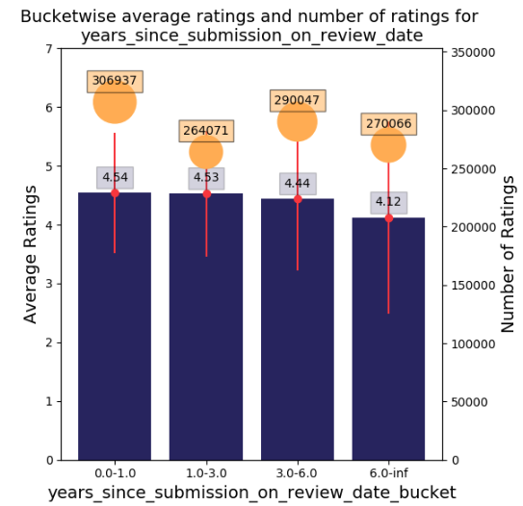
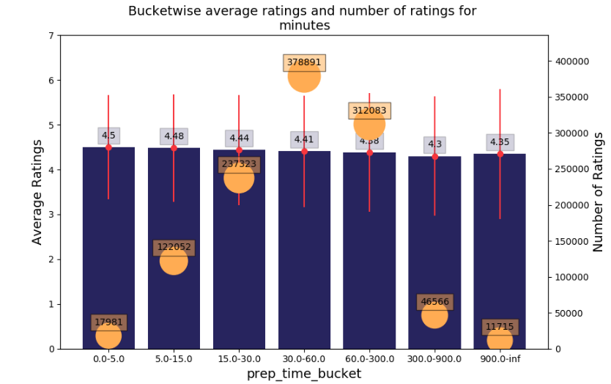
EDA
Recipes with lower prep time has the highest avg ratings of 4.5
No of ratings is highest for prep time 30-60 mins
Recipes more than 6 years old are rated low
Recipes from 0-3 years have the highest ratings

Slide 5
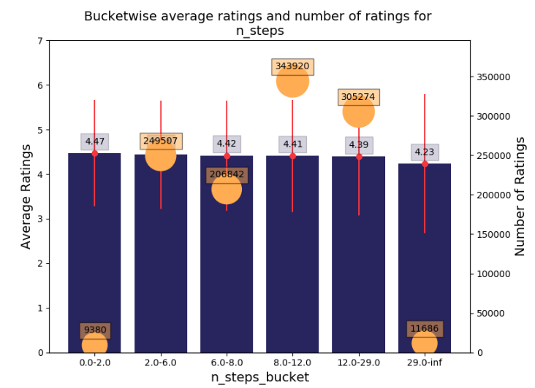
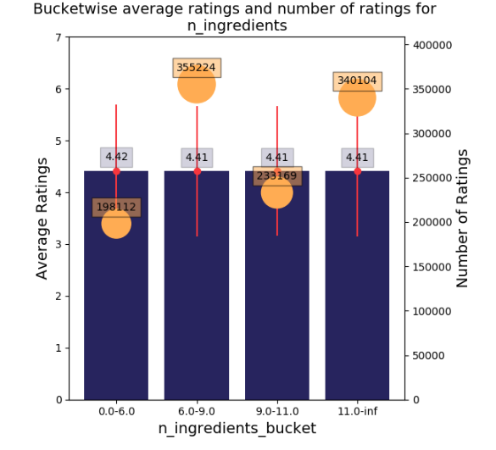
Recipes with less than 2 steps are rated high
Recipes with more than 29 steps are rated very low
The average ratings are almost similar irrespective of the number of ingredients

Slide 6
INSIGHTS FROM EDA
Prep time is somewhat relevant
Low prep time is preferred
Number of steps is clearly relevant
Low number of steps is preferred
Number of ingredients is not relevant
The top most rated tags are : #easy,#occasion,#equipment,#cuisine
Bottom Least rated tags are: lamb=sheep-main-dish, black-bean-soup which is present only 1 in over 200000, so one hot encoding of these tags is not a good idea.

Slide 7
THANK
YOU

